Slide 1
Scikit-learn
Francesco Bellotti, Univ. Genova

Slide 2
Scikit-learn
Tutorial to into the data and classification algorithms
Explore (plot) data
Preprocess and Training_testing_set
Transform categorical columns into numeric, select columns
3 algorithm examples (NB, Linear SVC, k-nn)
Classification report
2 further examples

Slide 3
1_Countplot
Use seaborne package
Countplot()
Plot histograms of 1, 2 categorical variables
Catplot()
Plot also third category
https://seaborn.pydata.org/generated/seaborn.countplot.html

Slide 4
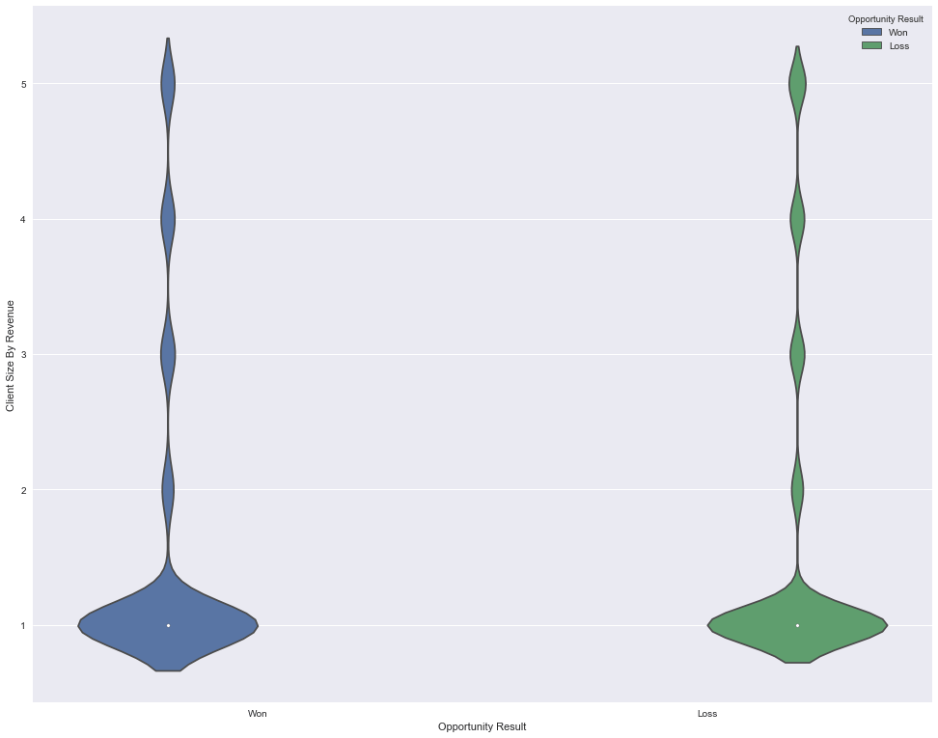
2_explore_data
Use seaborne package
Countplot()
Violinplot()
https://www.dataquest.io/blog/sci-kit-learn-tutorial/

Slide 5
Preprocess
Input file for all algorithms: win loss of a marketing campaign
sklearn.preprocessing.LabelEncoder to convert the categorical columns into numeric
Fit_transform()
uinque() on a dataframe column
https://www.dataquest.io/blog/sci-kit-learn-tutorial/

Slide 6
Training_testing_set
Select data columns by removing others
Select target column
from sklearn.model_selection import train_test_split

Slide 7
K-nn
Intuition of the algorithm
Construction with hyperparameter (k)
fit() on the training set
predict() on the testing set
accuracy_score
Classification_report() in figure with yellowbrick

Slide 8
Linear SVC
Intuition of the algorithm
https://blog.statsbot.co/support-vector-machines-tutorial-c1618e635e93
Same as before
Notes:
C as a tradeoff between having a wide margin and having few errors in training data (small C => large tolerance) - Prevent overfitting
Plane in 3D, projected back to 2D becomes a hyperbola
Generalization, kernel

Slide 9
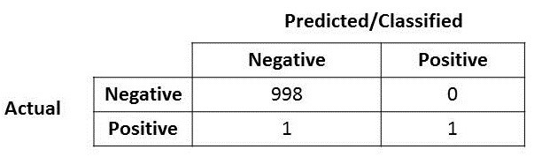
Naive Bayes
We’ll see better the algorithm later.
Now focus only in classification report
https://towardsdatascience.com/accuracy-precision-recall-or-f1-331fb37c5cb9
Confusion matrix
Accuracy

Slide 10
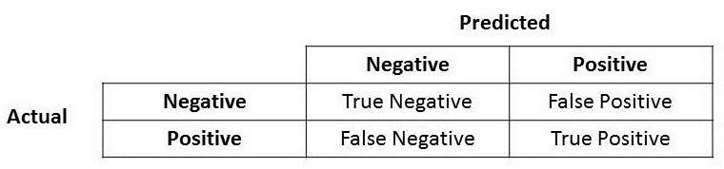
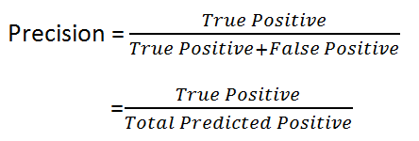
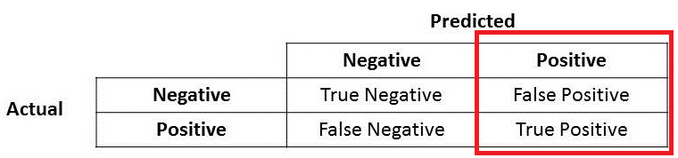
Precision
Precision important when false positive important: e.g., spam detection

Slide 11
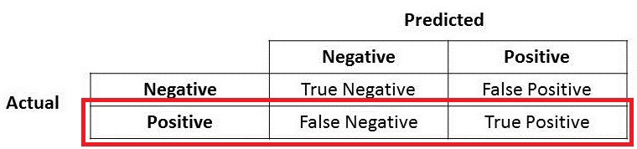
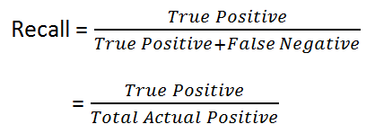
Recall
Recall important when false negative important: e.g., fraud, assassin

Slide 12

F1 score
F1 Score might be a better measure to use if we need to seek a balance between Precision and Recall AND there is an uneven class distribution (large number of Actual Negatives)

Slide 13
8_iris_digit_tutorial
https://scikit-learn.org/stable/tutorial/basic/tutorial.html
Training, testing with predict()
Model persistence with pickle
Reduce dimensionality through Gaussian random projection
Type casting
Target a categorical variable (not numeric)
Model refitting (e.g., with different SVM kernels)
Multiclass
OneVsRestClassifier () vs Linear vs non linear svm (default: Radial Basis Function)

Slide 14
9_digit_example
https://scikit-learn.org/stable/auto_examples/classification/plot_digits_classification.html#sphx-glr-auto-examples-classification-plot-digits-classification-py

